Slide 1
Five Ways to Wellbeing
In school we have spent a lot of time
talking about the 5 ways to wellbeing and how
they can have a positive impact on our
mental health and wellbeing!

Slide 2
What is mental health and wellbeing?
Mental health and wellbeing for children means that we are able to;
feel happy and positive about ourselves
enjoy life
learn well
have healthy and happy relationships with family and friends
manage sad, worrying or angry feelings
bounce back from tough times
“I spend time with my family” “I go for a run” “I walk” “I make time for myself” “I take the dog for a walk” “I meet up with my friends” “I read and do crosswords” “I paint” “I take a relaxing bath” “I eat a balanced diet” “I get a massage” “I try to stay organised” “I relax with family and friends” “I play in a band” “I find time to do things I enjoy” “I exercise regularly” “I attend to my work/life balance” “I talk to family and friends” “I make sure that I have something to look forward to” “I laugh” “I go to the gym” “I try to be nice to people” “I engage with my children” “I do interesting things” “I remember how lucky I am” “I find time to do things I enjoy” “I keep positive” “I pursue hobbies that I enjoy” “I smile” “I meditate” “I spend time with my children” “I get outside whenever I can” “I sing” “I help my children with their schoolwork”

Slide 3
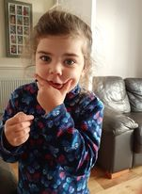
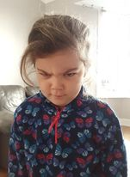
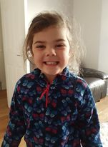
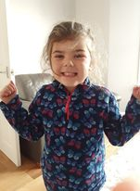
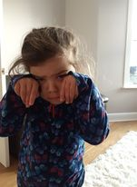
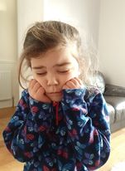
What is mental health and wellbeing?
It is perfectly normal for all of us to experience different emotions from day to day.
Sometimes we can even experience a whole load of different emotions in one day!!
worried
angry
happy
excited
sad
fed up
“I spend time with my family” “I go for a run” “I walk” “I make time for myself” “I take the dog for a walk” “I meet up with my friends” “I read and do crosswords” “I paint” “I take a relaxing bath” “I eat a balanced diet” “I get a massage” “I try to stay organised” “I relax with family and friends” “I play in a band” “I find time to do things I enjoy” “I exercise regularly” “I attend to my work/life balance” “I talk to family and friends” “I make sure that I have something to look forward to” “I laugh” “I go to the gym” “I try to be nice to people” “I engage with my children” “I do interesting things” “I remember how lucky I am” “I find time to do things I enjoy” “I keep positive” “I pursue hobbies that I enjoy” “I smile” “I meditate” “I spend time with my children” “I get outside whenever I can” “I sing” “I help my children with their schoolwork”

Slide 4
What is mental health and wellbeing?
Click on this link to watch a video….
“I spend time with my family” “I go for a run” “I walk” “I make time for myself” “I take the dog for a walk” “I meet up with my friends” “I read and do crosswords” “I paint” “I take a relaxing bath” “I eat a balanced diet” “I get a massage” “I try to stay organised” “I relax with family and friends” “I play in a band” “I find time to do things I enjoy” “I exercise regularly” “I attend to my work/life balance” “I talk to family and friends” “I make sure that I have something to look forward to” “I laugh” “I go to the gym” “I try to be nice to people” “I engage with my children” “I do interesting things” “I remember how lucky I am” “I find time to do things I enjoy” “I keep positive” “I pursue hobbies that I enjoy” “I smile” “I meditate” “I spend time with my children” “I get outside whenever I can” “I sing” “I help my children with their schoolwork”

Slide 5
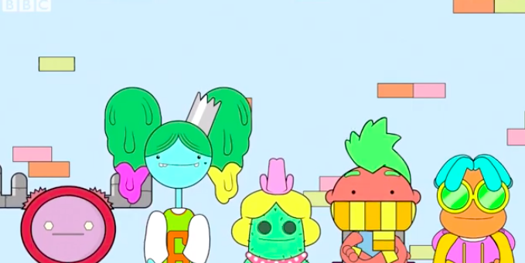
What is mental health and wellbeing?
Some people worry that the emotions they feel aren’t ‘normal’.
But they are and we all go through them all in our lives.
Having a positive mental health and wellbeing means finding ways to deal with all of the different emotions we have
“I spend time with my family” “I go for a run” “I walk” “I make time for myself” “I take the dog for a walk” “I meet up with my friends” “I read and do crosswords” “I paint” “I take a relaxing bath” “I eat a balanced diet” “I get a massage” “I try to stay organised” “I relax with family and friends” “I play in a band” “I find time to do things I enjoy” “I exercise regularly” “I attend to my work/life balance” “I talk to family and friends” “I make sure that I have something to look forward to” “I laugh” “I go to the gym” “I try to be nice to people” “I engage with my children” “I do interesting things” “I remember how lucky I am” “I find time to do things I enjoy” “I keep positive” “I pursue hobbies that I enjoy” “I smile” “I meditate” “I spend time with my children” “I get outside whenever I can” “I sing” “I help my children with their schoolwork”

Slide 6
What is mental health and wellbeing?
One of the ways that we can look after ours and each others
mental health and wellbeing is by following the ‘Five Ways To Wellbeing’.
Why the Five ways to Wellbeing?
Like physical health, we can all benefit from looking after our mental health.
There has been a lot of research by many professionals who have identified these 5 simple things that we can do.
When practised regularly, they can build resilience (help us find our brave), boost wellbeing and help to protect us from developing mental health problems.
These 5 simple things can help everyone! Not just people who are struggling with mental health.
“I spend time with my family” “I go for a run” “I walk” “I make time for myself” “I take the dog for a walk” “I meet up with my friends” “I read and do crosswords” “I paint” “I take a relaxing bath” “I eat a balanced diet” “I get a massage” “I try to stay organised” “I relax with family and friends” “I play in a band” “I find time to do things I enjoy” “I exercise regularly” “I attend to my work/life balance” “I talk to family and friends” “I make sure that I have something to look forward to” “I laugh” “I go to the gym” “I try to be nice to people” “I engage with my children” “I do interesting things” “I remember how lucky I am” “I find time to do things I enjoy” “I keep positive” “I pursue hobbies that I enjoy” “I smile” “I meditate” “I spend time with my children” “I get outside whenever I can” “I sing” “I help my children with their schoolwork”

Slide 7
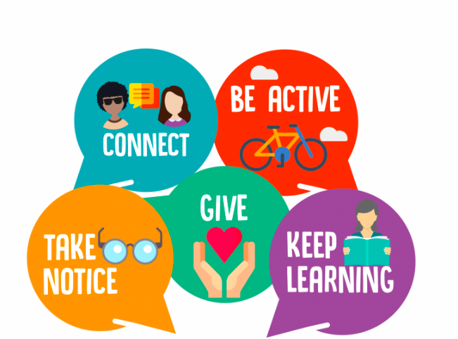
The “Five Ways to Wellbeing are…
Connect... Keep learning... Be active... Take notice... Give...

Slide 8
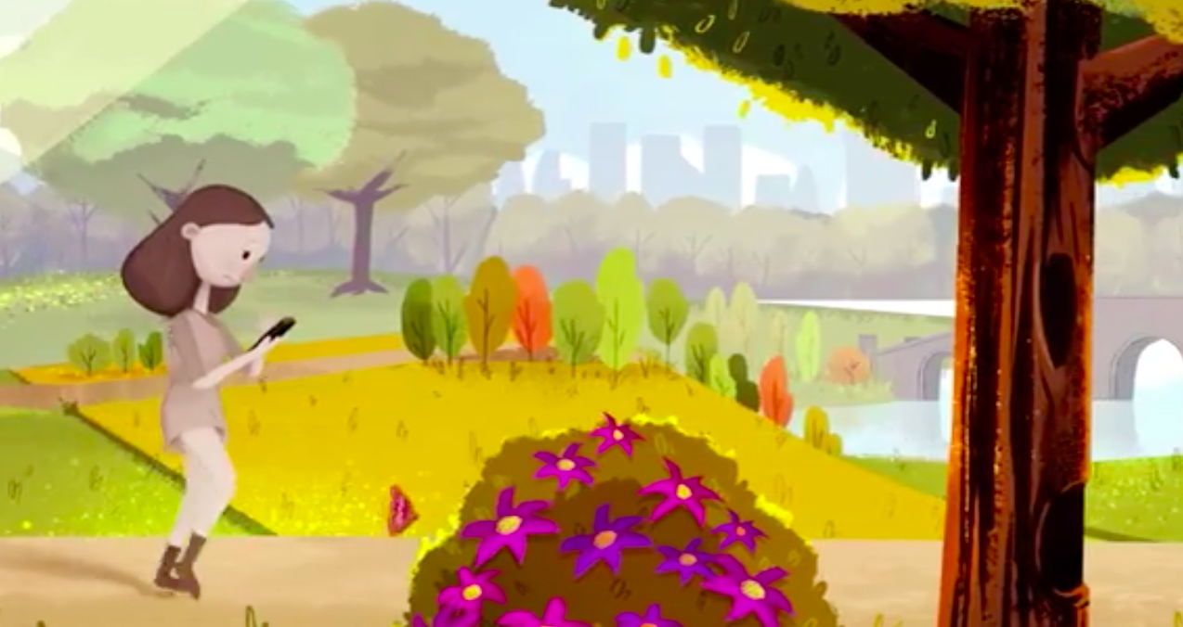
The “Five Ways to Wellbeing are…
Click on the image below for a video…
Connect... Keep learning... Be active... Take notice... Give...

